Slide 1
Storyboard

Slide 2
Headlines
Evaluating the Role of Volatility in Predictive Model and Exploring Volatility Behavior From SET Index to Individual Stocks
Exploratory Analysis on New Normal Behavior from Predictive Model on SET Index to Feature Changes among Individual Stocks

Slide 3
Evaluating the Role of Volatility in Predictive Model and Exploring Volatility Behavior From SET Index to Individual Stocks

Slide 4
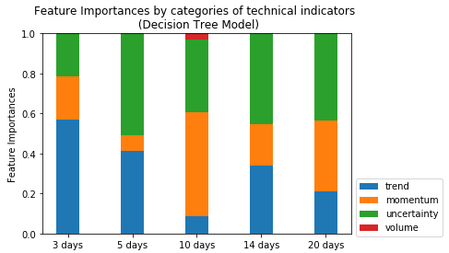
Decision Tree -> Feature Importances

Slide 5
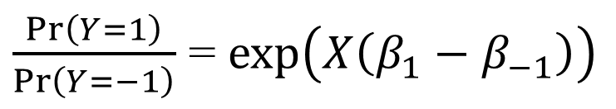

Logistic Regression -> Interpret Coeff
$\operatorname{Pr}\left(Y=−1\right)=\frac{\exp\left(Xβ_{−1}\right)}{Z}$
$\operatorname{Pr}\left(Y=0\right)=\frac{\exp\left(Xβ_{0}\right)}{Z}$
$\operatorname{Pr}\left(Y=1\right)=\frac{\exp\left(Xβ_{1}\right)}{Z}$
$\frac{\operatorname{Pr}\left(Y=1\right)}{\operatorname{Pr}\left(Y=−1\right)}$ = $\exp\left(X\left(β_{1}−β_{−1}\right)\right)$
Coeff of interest
“odd” ratio
Ref: https://en.wikipedia.org/wiki/Multinomial_logistic_regression#As_a_log-linear_model

Slide 6
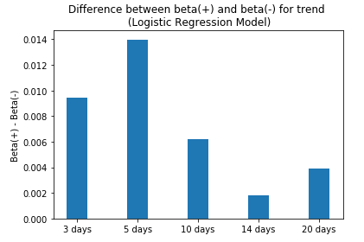
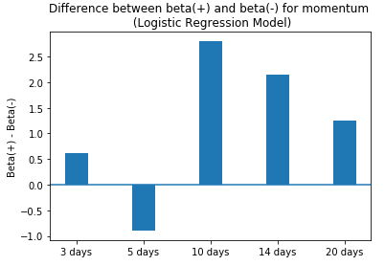
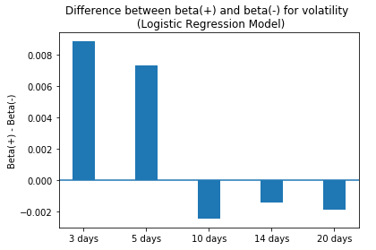
Logistic Regression -> Interpret Coeff

Slide 7
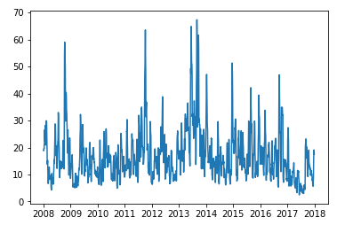
SET IDX STD and VAR
Possible Explanations:
- Volatility Clustering
- Responses to Shocks
14-day STD

Slide 8
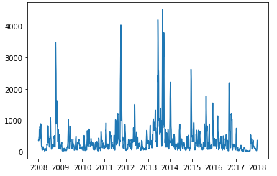
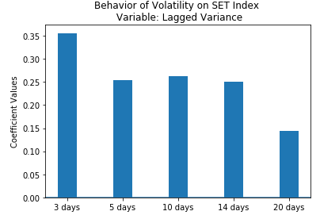
Volatility clustering

Slide 9
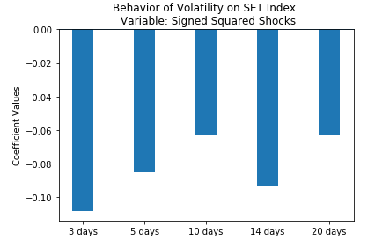
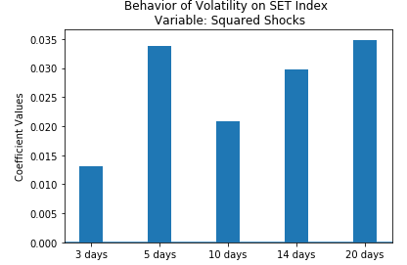
Responses to Shocks

Slide 10
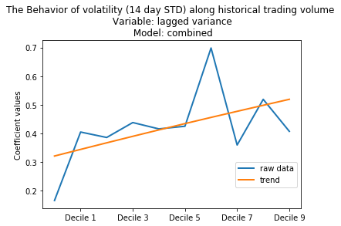
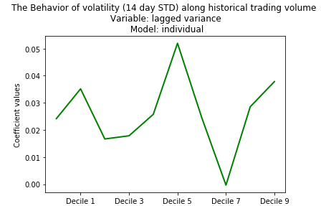
Volatility Clustering

Slide 11
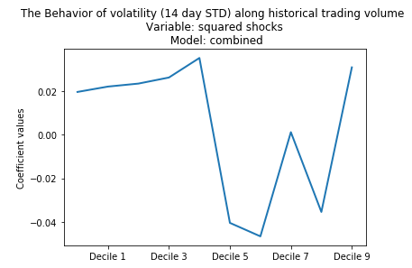
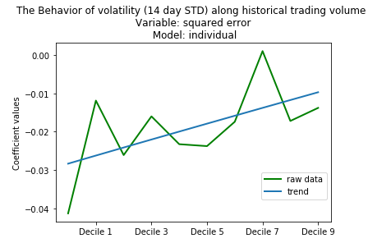
Response to Negative Shocks

Slide 12
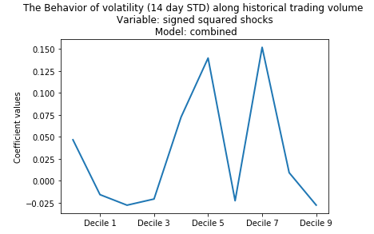
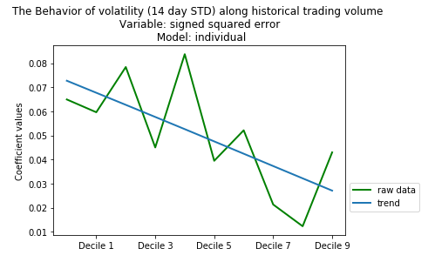
When the Response is Positive

Slide 13
Exploratory Analysis on New Normal Behavior from Predictive Model on SET Index to Feature Changes among Individual Stocks

Slide 14
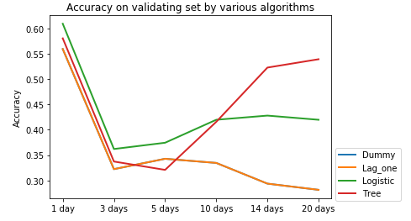
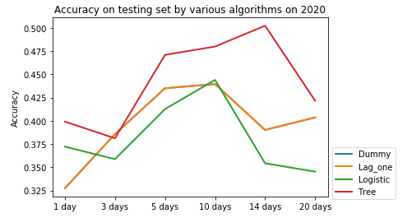
Different Testing Periods => Different Results

Slide 15

How about Individual Stocks?
Variables of Interest
- Distribution of Y
- MACD
- MOM
- STD
- Vol Signal
Variables of Interest
- Distribution of Y
- MACD
- MOM
- STD
- Vol Signal
Year
(2015-2020)
FLATTEN
Variables of Interest
- Distribution of Y
- MACD
- MOM
- STD
- Vol Signal
Year
(2015-2020)
Historical Trading Volume
(Decile 1 – Decile 10)
Historical Trading Volume
(Decile 1 – Decile 10)

Slide 16
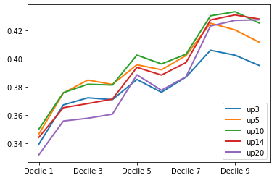
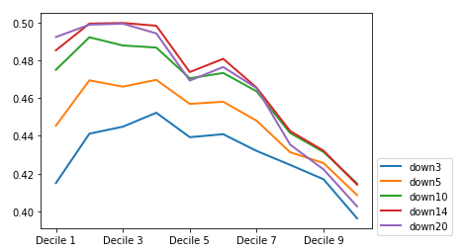
Distribution Variance among Individuals

Slide 17
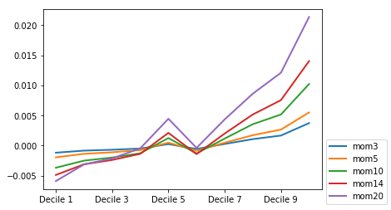
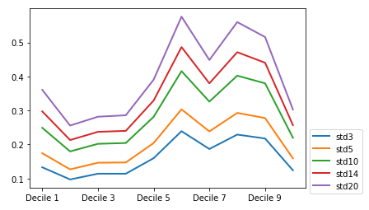
Distribution Variance among Individuals

Slide 18
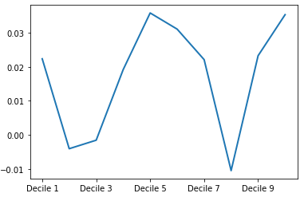
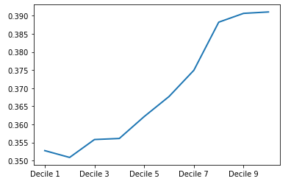
Distribution Variance among Individuals
MACD Vol Signal

Slide 19
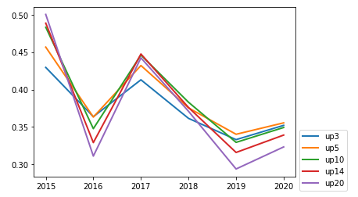
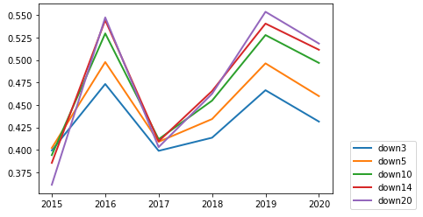
Changes Across Years

Slide 20
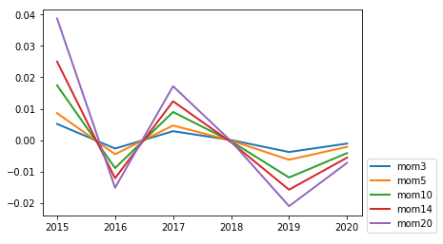
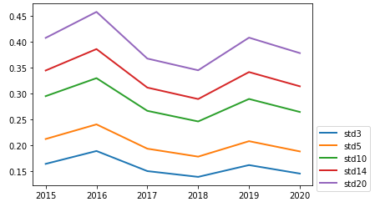
Changes Across Years

Slide 21
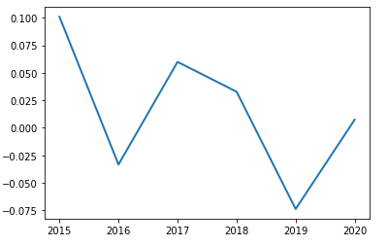
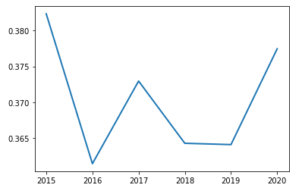
Changes Across Years
MACD Vol Signal

